Slide 1
Latent Class Analysis in Psychology
2016 © Paweł Kleka
Remedy for weak data?
Notes:
Who am I....
i don't have any big idea to present. only my small thought about state of the analysis in psychology
Researchers in psychology like to be treated as empirical scientist (i am psychologist and this is mole job. some colleagues can stop talking to me after this)

Slide 2

Assumptions
Linear relationship
Normal distribution
Homogenity of varaiance
very often we fail to achieve on data from psychological tests
!missed!
Notes:
we use more often parametric statistics than non parametric and used to pretend that our data are strong as data from biology, economy, physic or other empirical science
we feel uncomfortable (same of us) but editors and peer reviewers make pressure to use common methods present in popular statistical packages.
if i used in paper some non parametric estimator i have to explain why i do this and report if parametric one does not give the similar results
this is strange situation when in statistical universe exists robust methods
now some words about one of them on my field which i found accidentally which hasn't typical assumptions

Slide 3
Assumption of LCA
Classes exists
Inside class data are independent
Sum of conditional probability for cases inside class = 1
Notes:
latent class analysis has simpler assumptions:
class have to exist, locally independence, and some statements about conditional probability
that's all!

Slide 4
Advantages over traditional types of analysis
Classification based on probability
Factors without rotating
ML estimates directly from model
Different models of regression for group of cases (R > 1)
Variables may be continuous, categorical, counts or any combinations of these
Covariates can be used within modelling for better description
Notes:
i wrote down some advantages for latent class classifications models, regression models or factor models
for my field of work the most important is possibility to mix variables on different level of measurement. this situations are common in psychology

Slide 5
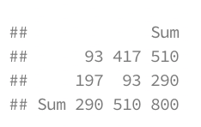
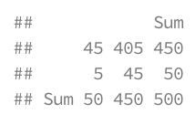
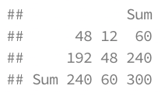
Finding classes
Games of Throne
Like / Dislike
Breaking Bad
Like / Dislike
Notes:
let's look on the simple sample. In the top cross table we see frequencies of people's likes about two popular tv series. obviously there's correlation between the scores. LCA works in this way, that looking for hidden class for every observation that allow reduce dependency in the most. on the end we have classification which explains previously observed dependency.

Slide 6
How is this modelling process conducted?
Estimation via the EM algorithm
Start with random split of cases into classes.
Reclassify based on a improvement criterion
Reclassify until the best classification of cases is found.
Notes:
how it's work?
it's possible thanks to computers and before twentieth century was only theoretical possibility of computing
Lazerfield 1950 - typology for dichotomies
Goodman 1974 - MLE + polytomous variables
Vermunt 1997 - framework

Slide 7
Evaluating the Model
Model Fit
BIC and AIC
X² Statistic
Goodman test
Notes:
Some words about assessing model fit. In LCA model are ordered by number of classes and this one which has better parameters wins. The model with smaller number of classes and good BIC and or AIC is better.
We can look on results of chi square and goodman test too.

Slide 8
Packages with Latent Class Analysis
 | Classification | Regression models
lca {e1071} | Yes | No
gllm {gllm} | Yes | No
fast_lca {svs} | Yes | No
poLCA {poLCA} | Yes | Yes
Notes:
There is some commercial software on the market but I don't use them and won't making advertising for them.
After researching CRAN I found only four packages dealing with Latent Class Analysis, but no ones dealing with Latent Class Factor Analysis.

Slide 9

LC Cluster Model
Observed Continuous or Categorical Items (Y)
Categorical Latent Class Variable (C)
Y₁
Y₂
Y₃
Y_{n}
. . .
C
Notes:
First example is about LC Cluster Model.
We have bunch of variables and looking for clusters which reduces dependency the most.

Slide 10
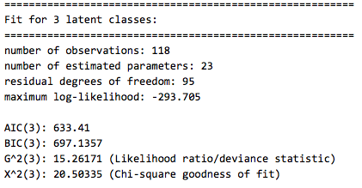
Linzer, D.A., Lewis, J.B. (2011). poLCA: An R Package for Polytomous Variable Latent Class Analysis, Journal of Statistical Software 42(10).
Notes:
Researchers shows that this approach is equivalent or better than k-means.

Slide 11

LC Regression model
Observed Continuous or Categorical Items (Y)
Categorical Latent Class Variable (C)
Continuous or Categorical Covariates (X)
Y₁
Y₂
Y₃
Y_{n}
. . .
X
C
Notes:
Second example is a LC Regression Model with covariant. We can add heir one or more variables on any levels of measurement.

Slide 12
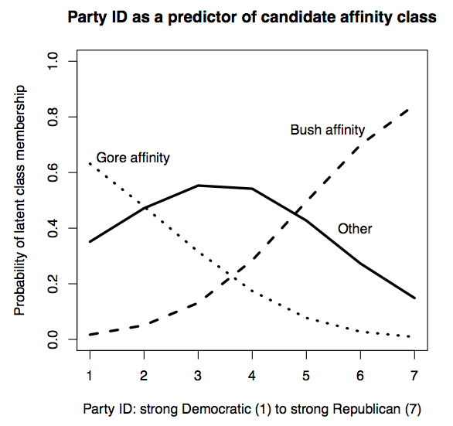
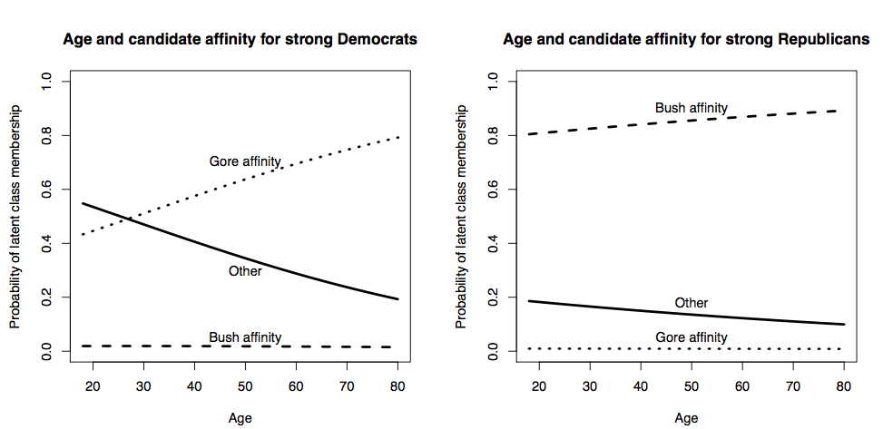
Linzer, D.A., Lewis, J.B. (2011). poLCA: An R Package for Polytomous Variable Latent Class Analysis, Journal of Statistical Software 42(10).
Notes:
We have first solution on the top. We seeing affinity for Gore or for Bush depends on which party respondents supports more.
After adding the Age to model, we see that in democratic groups Age matters.
Results are presented as probabilities and I think that is very clear way to talk to the non statisticians.

Slide 13
Numbers of articles in psychological databases
 | Theoretical | Empirical
 | About Latent Class | Latent Class Cluster Analysis | Cluster Analysis [without Latent Class]
2010 - 2016 | 5560 | 435 | 50626
2000 - 2010 | 2267
1990 - 2000 | 351
1980 - 1990 | 119
Databases: PsycInfo, PsycArticles, Academic Search Complete
Notes:
For the end, how often this method of analysis is used in psychology?
Theoretically with development of measurement numbers of papers increase.
But this doesn't affect empirical studies.
It's sad but true.

